Slide 1
Инфраструктурни решения за контейнеризация

Slide 2

Docker

Slide 3
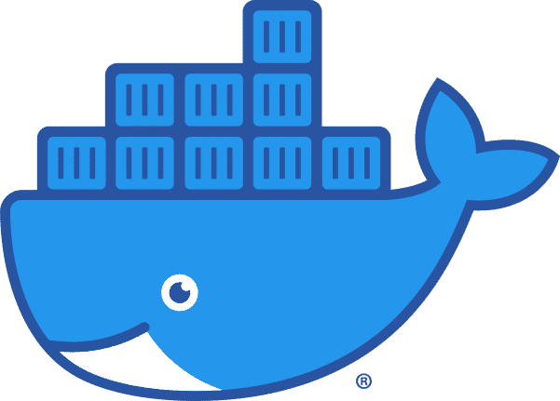
What is Docker ?
The company Docker, Inc.
Docker the container runtime and orchestration engine.
Docker the open source project (Moby)
Important correction
Containers do NOT run on docker!
Containers are processes - they run on the Linux Kernal.
The Docker Deamon is one of the many user space tools/libraries that talks to the kernel to set up containers

Slide 4
The Docker Company.
Start as a PaaS provider called dotCloud
Found by Solomon Hykes
dotCloud leveraged Linux Containers
Their internal tool used to manage containers was nick-named Docker
In 2012, dotCLoud was rebraned as Docker

Slide 5

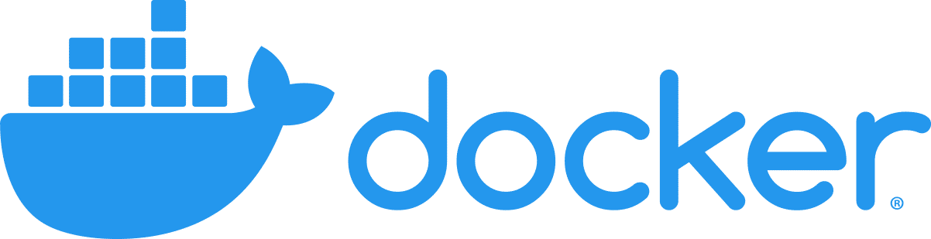
The Docker runtime and orchestration engine.
Two Main Editions:
  Enterprise Edition (EE)
  Community Edition (CE)
Both are released quarterly
  EE is supported for 12 months
  CE is supported for 4 months
Moby (The Open-Source Project):
  The upstream project of Docker
  Modular architecture
  Code is available on GitHub.
Enterprise Edition
Community Edition

Slide 6
Docker Use Cases:
Dev/Prod Parity
Simplifying Configuration
Code Pipeline Management
Developer Productivity
App Isolation
Server Consolidation
Debugging Capabilities

Slide 7
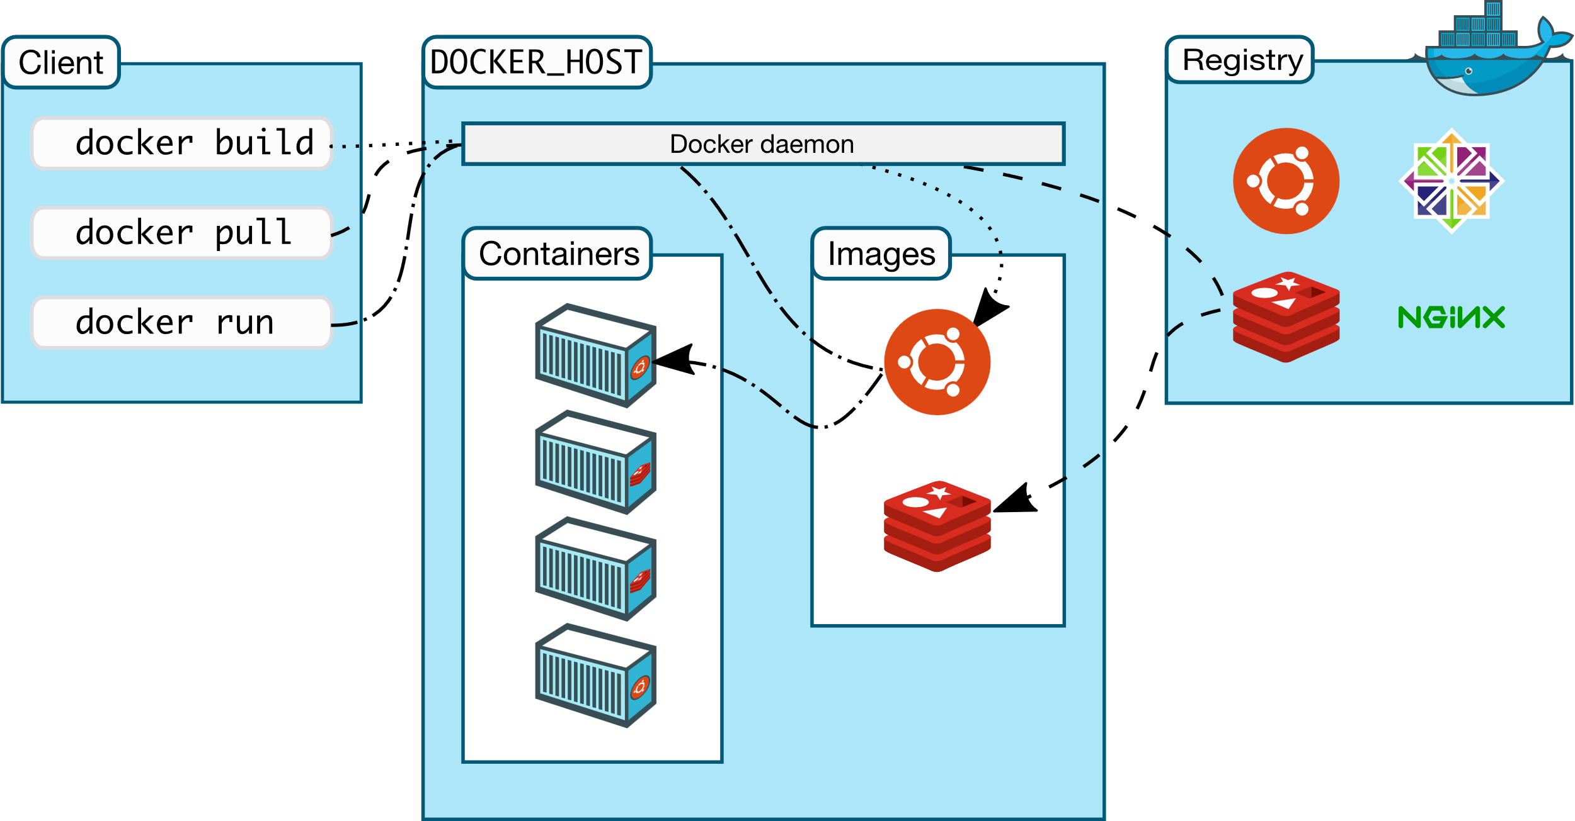
Architecture Overview

Slide 8
Docker Architecture
Client-Server architecture
The client talks to the Docker daemon
The Docker daemon handles:
  Building
  Running
  Distributing
Both Communicate using a RESR API:
  UNIX Sockets
  Network Interface
Docker Client
$ docker build
$ docker pull
$ docker run
Docker deamon

Slide 9
The Docker daemon (dockerd)
Listens for Docker API request and manages Docker objects:
  Images
  Containers
  Network
  Volumes
Image
Container
Alpine
Docker deamon
App

Slide 10
Docker registries
Stores Docker Images
Public registries:
  Docker Hub
  Azure Container Registry
  Google Container Registry
  Google Artifact Registry
  Amazon EC2 Container Registry
  Bintray.io/Artifactory
  Quay.io
  Github Container Registry
Self-hosted registries are:,
  The official registry by Docker
  Nexus by Sonatype
  Harbor by VMware
  Portus by Suse
  Container Registry by Alibaba
  Openshift registry by RedHat
  Kraken by Uber
  Proget by Inedo

Slide 11
Docker objects:
Images:
  Red-Only template with instructions for creating a Docker container.
  Image is based on another image.
  Create your own images.
  Use a Dockerfile to build images.
  Can be create form container current state
Containers
  Isolated from other containers and the host machine
  Runnable instance of an image
  Connect a container to a networks

Slide 12
Install Docker - Demo

Slide 13
Container Terminology
Container: In Linux, containers are an operating system virtualization technology used to package applications and their dependencies and run them in isolated environments.
Container Image: Container images are static files that define the filesystem and behavior of specific container configurations. Container images are used as a template to create containers.
Container Orchestration: Container orchestration is a term used to describe the processes and tooling required to manage fleets of containers across multiple hosts. Container orchestration typically controls scaling, fault tolerance, resource allocation, and scheduling using a container platform.
Container Runtime: A container runtime is the component that actually runs and manages containers on a host. The minimum requirement is usually to be able to provision a container from a given image, but many runtimes bundle other functionality like process management, monitoring, and image management. Docker includes a container runtime within it’s docker command, but there are many other alternatives available for different use cases.
Docker: Docker was the first technology to successfully popularize the idea Linux containers. Among others, Docker’s ecosystem of tools includes docker, a container runtime with extensive container and image management features, docker-compose, a system for defining and running multi-container applications, and Docker Hub, a container image registry.
Dockerfile: A Dockerfile is a text file describing how to build a container image. It defines the base image, the commands to run within the system, and way that the runtime should start and manage the processes within the container. While not the only option, Dockerfiles are the most common format for defining container images, even when not using Docker’s image building functionality.

Slide 14
Container Terminology
Linux cgroups: Linux cgroups, or control groups, are a kernel feature that bundles processes together and determines their access to resources. Containers in Linux are implemented using cgroups in order to manage resources and separate processes.
Linux namespaces: Linux namespaces are a kernel feature designed to limit the visibility for a process or cgroup to the rest of the system. Containers in Linux use namespaces to help isolate the workloads and their resources from other processes running on the system.
LXC: LXC is a form of Linux containerization that predates Docker and many other technologies while relying on many of the same kernel technologies. Compared to Docker, LXC usually virtualizes an entire operating system rather than just the processes required to run an application, which can seem more similar to a virtual machine.
Virtual Machines: Virtual machines, or VMs, are a hardware virtualization technology that emulates a full computer. A full operating system is installed within the virtual machine to manage the internal components and access the computing resources of the virtual machine.
Virtualization: Virtualization is a process of creating, running, and managing virtual environments or computing resources. Virtualization is a way of abstracting physical resources and is often used to segment a pool of resources for different purposes.

Slide 15

Thank You!

